Slide 1
Clinical application of Electron beams:
Shibu Anamalayil, MS

Slide 2
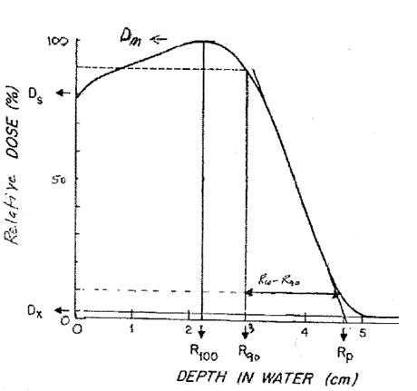
% Depth Dose

Slide 3
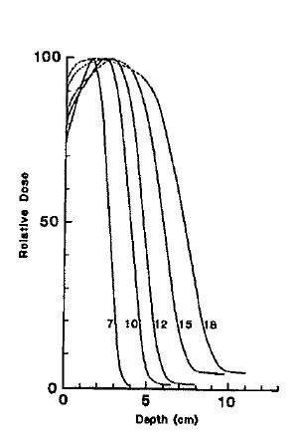
Depth Dose energy Dependence (6-20MeV)
As energy increases
Surface dose (Ds) increases (70%-90%)
Therapeutic depth( R₉₀) increases.
Dose falloff (R₁₀-R₉₀) increases.
Practical range (Rp) increases.
Bremsstrahlung dose (Dx) increases.

Slide 4
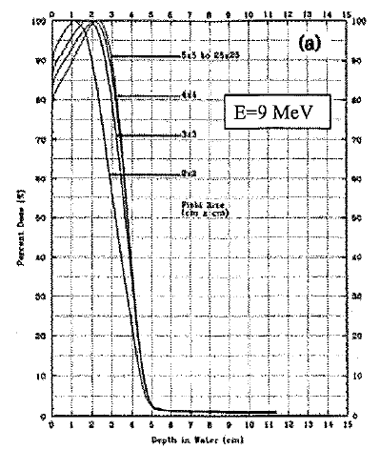
% Depth Dose Filed size dependence
As field size decreases
Therapeutic depth( R90) decreases.
Surface dose(Ds) increases.
Practical range remains constant.
Increase of Ds more significant at lower energies.
Decrease in R90 is less significant at lower energies.

Slide 5
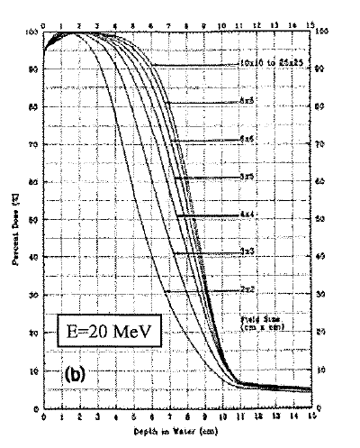
% Depth Dose Filed size dependence
As field size increases
Therapeutic depth( R90) decreases.
Surface dose(Ds) increases.
Practical range remains constant.
Increase in Ds less significant at higher energies.
Decrease in R90 more significant at higher energies
As field size decreases
Therapeutic depth( R90) decreases.
Surface dose(Ds) increases.
Practical range remains constant.
Increase in Ds almost insignificant at higher energies.
Decrease in R90 more significant at higher energies.

Slide 6
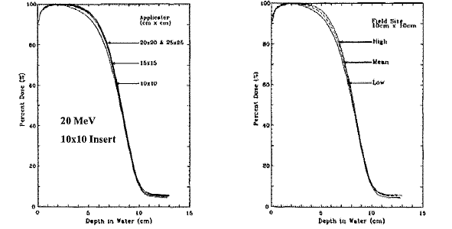
% Depth dose Applicator dependence
Dependence of %DD on applicator is minimal and is ignored. (Shiu et al., 1994)

Slide 7
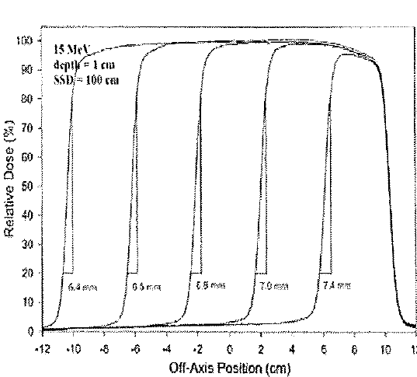
Penumbra-field size dependence
Penumbra is the edge of the beam where there is not side scatter equilibrium
Penumbra width is a measure of penumbra shape. P₈₀₋₂₀=distance from 80% to 20%
Penumbra width remains constant as field size increases if there is side scatter equilibrium on central axis

Slide 8
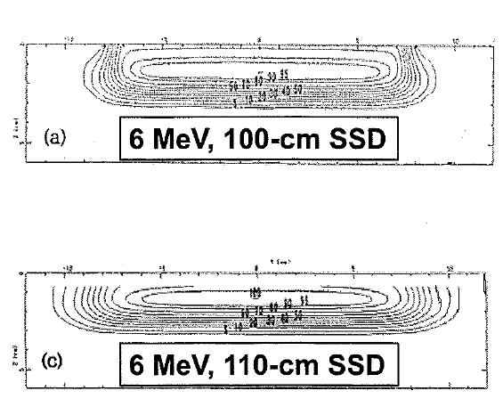
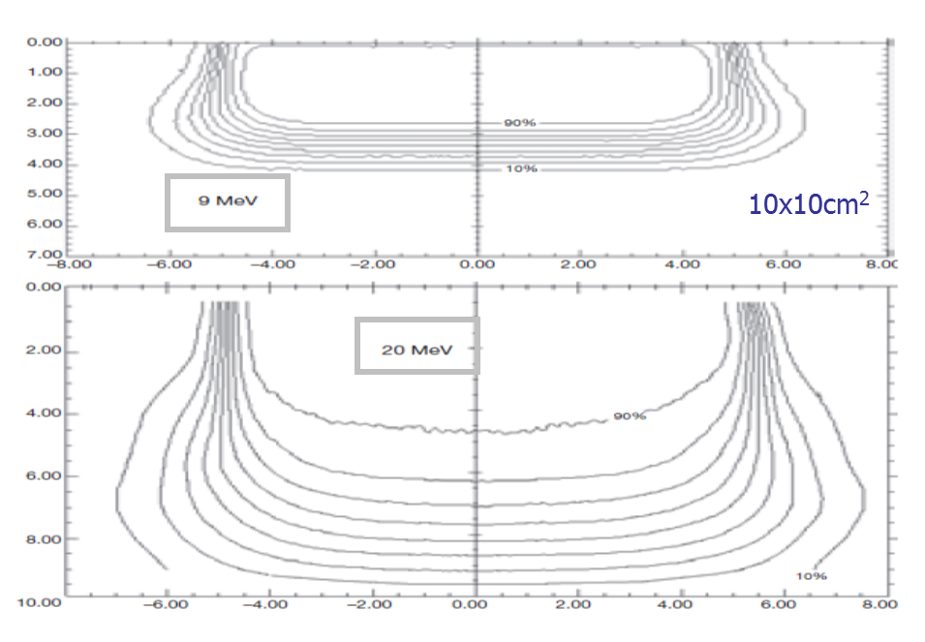
Penumbra – Energy and SSD dependence
Penumbra width at surface increases in proportion to air gap
Penumbra width at surface is sharper at higher energies

Slide 9
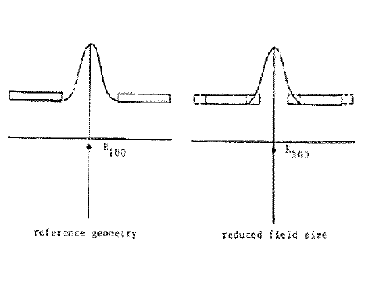
Output Field size dependence
Once the field size reaches below the practical range , the output increasingly begins to decrease as electrons previously reaching R100 are removed from the beam by collimation.
Loss of side scatter equilibrium
Electrons scattering off the edge of the collimator increases with increasing field size due to increased perimeter of aperture

Slide 10
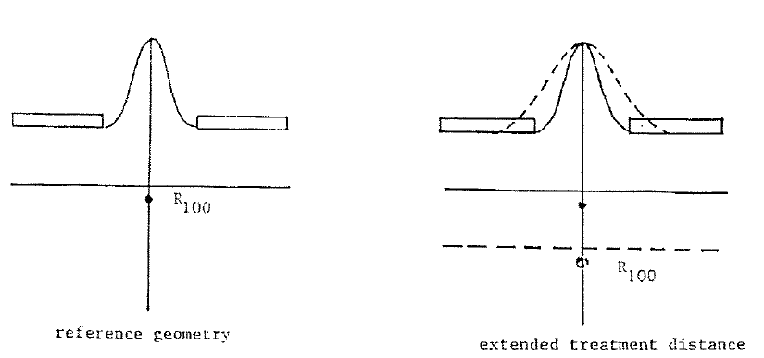
Output SSD dependence
Output decreases with increasing SSD ( ie, increasing air gap) due to 2 effects.
Inverse square effect from virtual source
Loss of side scatter equilibrium

Slide 11
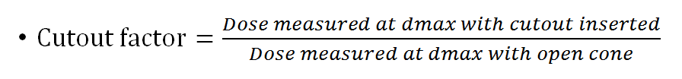
Output factor measurements:
Parallel plate chamber, small ionization chamber, or diode can be used for measurements.
Place the chamber at the center of the field at Dmax with 100SSD to the top of phantom.
For extended SSD setup, measure the cutout at clinical SSD and open cone at 100SSD. The measured output includes output factor and SSD factor.
If the cutout is highly irregular, measure at multiple points and take the average.
For small cut outs without lateral equilibrium, the Dmax will shift towards the surface. For these cases find the true Dmax with a PDD measurement using water tank or use 1mm solid water.

Slide 12
Influence of patient Anatomy on Electron dose Distribution
Patient Surface
Oblique incidence
Irregular surface
Internal Heterogeneities
Bone
Air
Lung

Slide 13
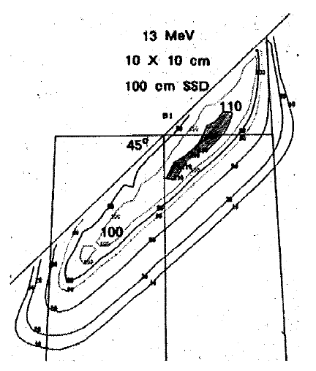
Effect of Oblique incidence on Dose distribution
Penumbra
Decreases for surfaces closer to source
Increases for surface farther from the source

Slide 14
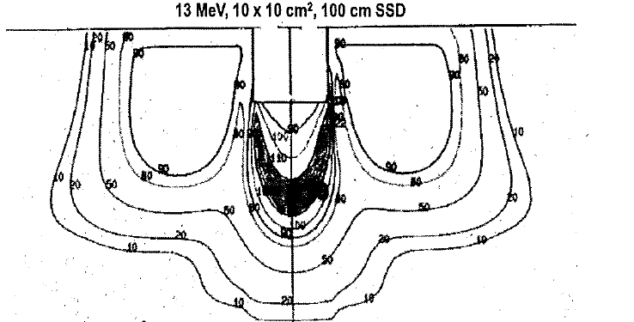
Effect of irregular surface on Electron dose distribution
Increased dose in shadow of depression
Decreased dose around its periphery

Slide 15
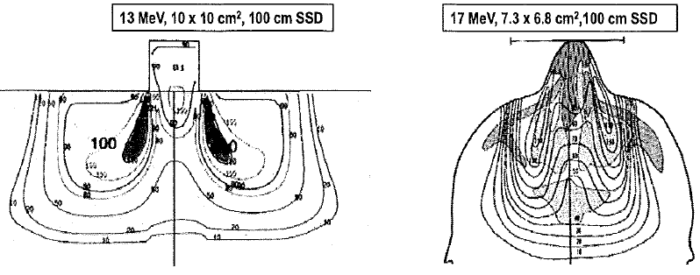
Effect of irregular surface on Electron dose distribution
Decreased dose in shadow of protrusion
Increased dose around its periphery

Slide 16
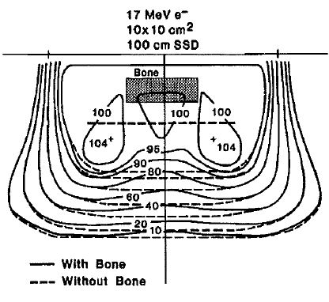
Effects of Bone on Electron dose distribution
Therapeutic dose contours( 80%-90%) shift toward surface
Hot spots lateral to bone and cold spots under bone.

Slide 17
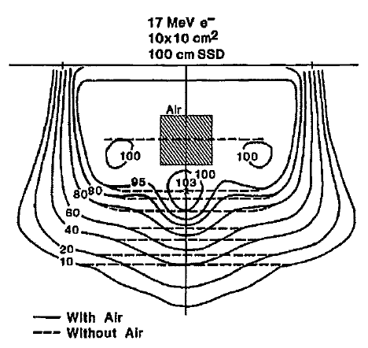
Effects of Air on Electron dose distribution
Dose falloff regions penetrates deeper
Hot/Cold spots can become significant ( as much as 20%)

Slide 18
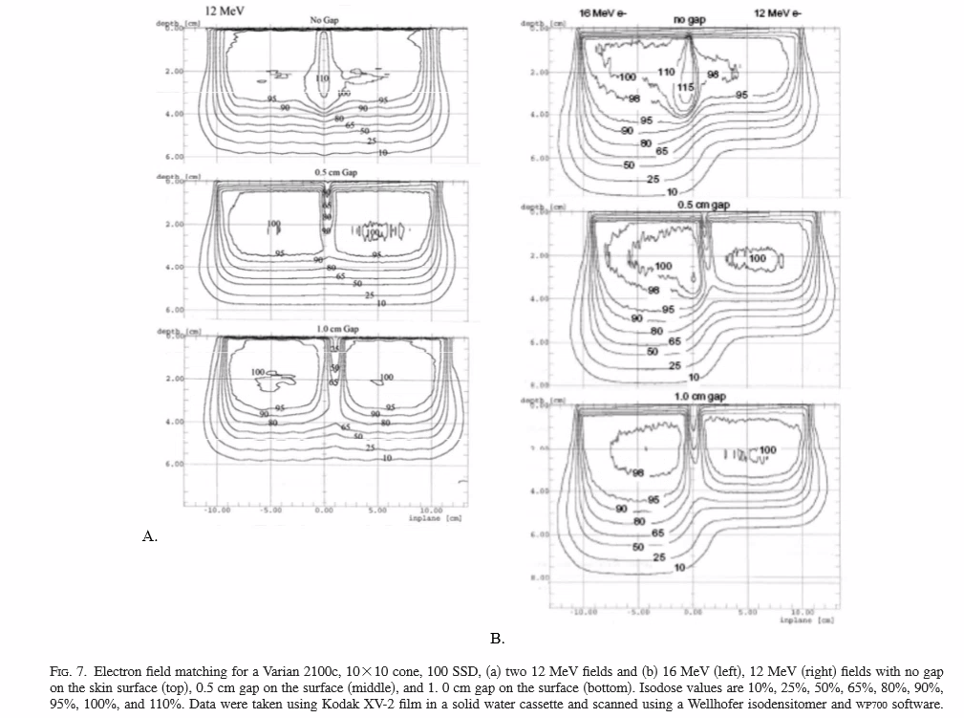
Electron-Electron Field Matching

Slide 19
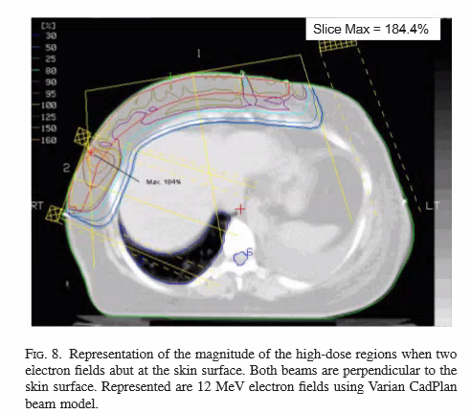
Electron Field matching contd..
Electron – Electron field matching needs special considerations.
Matching can cause unintended hot spots.
Matching of different beam angles causes even more hotspots.
Matching at the skin and feathering is the normal clinical approach.
Matching at skin

Slide 20
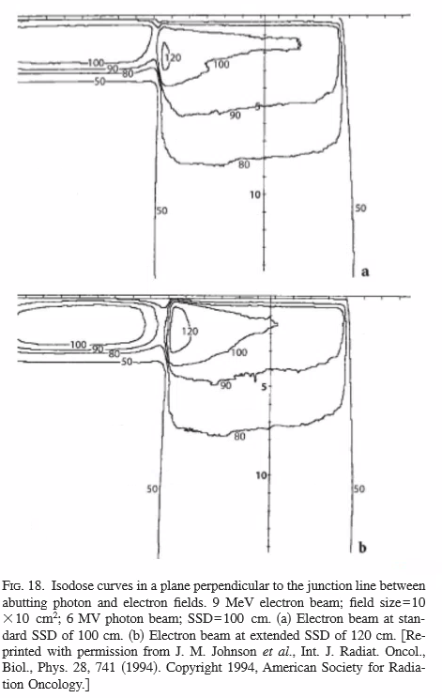
Electron-Photon Field Matching
Matching can cause unintended hot spots.
Hotspots are on the photon field side due to bulging of isodose lines.
Hotspots increases when extended SSD used.
Matching at the skin and feathering is the normal clinical approach.
IMN field matching for breast treatment planning is the most common.

Slide 21
Internal Shielding for electron treatments :
Treatment of lips, Buccal mucosa, eyelid lesions.
Lead shielding is used.
The dose enhancement due to back scatter at the tissue-lead interface can be in the range 30%-70% for 1MeV-20MeV with higher value for the lower energy.
To dissipate backscatter, a suitable thickness of low atomic number absorber such as bolus or wax can be placed between the lead tissue interface.

Slide 22
Clinical Electron – Rules
Beam energy should be selected to ensure that
R90 > maximum depth of PTV
Rp < depth of critical structure.
Practical range = Energy/2
R90~ Energy / 3.3
Energy loss in tissue is 2MeV/cm
Most probable energy in tissueEd= E0(1- d/Rp)
Lead thickness to block= Energy/2 in mm.
If Cerrebond : Use 1.2*Pb thickness.

Slide 23
Thank you
References :
The physics of radiation therapy: Third edition by Faiz M Khan PhD.
AAPM Therapy Physics review course by John A Antalock. PhD.
Recommendation of Clinical electron dosimetry: Supplement to the recommendation of TG25 by Gerbi etal..

